Slide 1
Analyst Boot Camp
Capstone Presentations

Slide 2
Stage 3: Group Capstone Debrief
Let’s discuss our group project with Stage 3:
What went well?
What challenged you the most?
What was easy?
With what you have experienced so far,
What would you like to do more / less? Why?
How do you think you could improve in these areas of focus?
Notes:
Pre-frame: we are all learning; we learn from each other and our approaches to work. Challenges and obstacles are opportunities to grow and learn from each other. Less than optimal results!! (aka fail) rat each other out, (reflect, respond, resolve)

Slide 3
Stage 3: Group Capstone Debrief
Let’s discuss our group project with Stage 3:
How did your group plan to accomplish the Stage 3 project?
What did you need to consider when planning your group project?
What challenges did your group encounter?
If you had to replicate the plan, how would you improve it?
Notes:
Accomplish: Deliverables
Consider in planning: Dependencies
Challenges: How did you track your progress?
Clear understanding of roles and responsibilities?
Did they have adequate resources to complete the project?
Improve = reflect
How did you handle the unexpected?

Slide 4
Project Management Best Practices
INTRODUCTION TO
WATERFALL AND AGILE
APPROACH

Slide 5
CAPSTONE PROJECT MANAGEMENT
There are many ways to approach your projects. You will need to complete a similar project to Stage 3’s but individually.
The components of your project include:
Project Management Plan (PMP)
ETL Documentation
Napkin Drawing
Visualizations
Presentation

Slide 6
Capstone Project Management Plan
How do I manage my project and meet deadlines?
How do I set myself up for success by planning with the end in mind?
There are many frameworks that help take your project work and break it down into smaller steps.
There are approaches that are iterative or adaptive in nature:
Iterative: step by step and in a predetermined order (Waterfall)
Adaptive: Cycles of iterative steps (Agile)
Notes:
We will review due dates for these capstone outputs in our next meeting. For now, managing your work can have a process. You may be using a process already and are unaware that you innately have used a methodology that Progressive encourages for us to use to manage projects.
Approaches to project management set us up for success.
Having a plan helps prevent us from getting halfway through our project and needing to fully recalibrate our project approach and possibly miss deadlines.

Slide 7
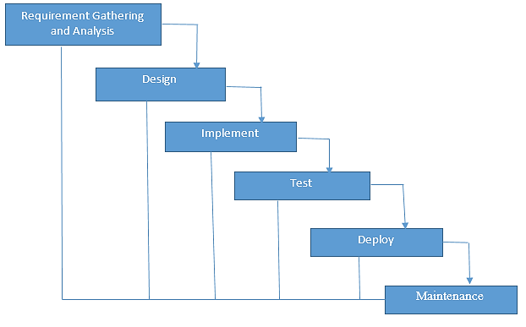
WATERFALL OVERVIEW
An iterative approach to project management:
Waterfall Development:
You complete one
phase (i.e., design)
BEFORE
moving onto the next
phase (i.e., development).
Notes:
Waterfall Development is another name for the more traditional approach to project development.
You rarely aim to revisit a ‘phase’ once it’s completed. That means, you better get whatever you’re doing right the first time!
But…
You don’t realize any value until the end of the project
You leave the testing until the end
You don’t seek approval from the stakeholders until late in the day
This approach is highly risky, often more costly and generally less efficient than Agile approaches

Slide 8
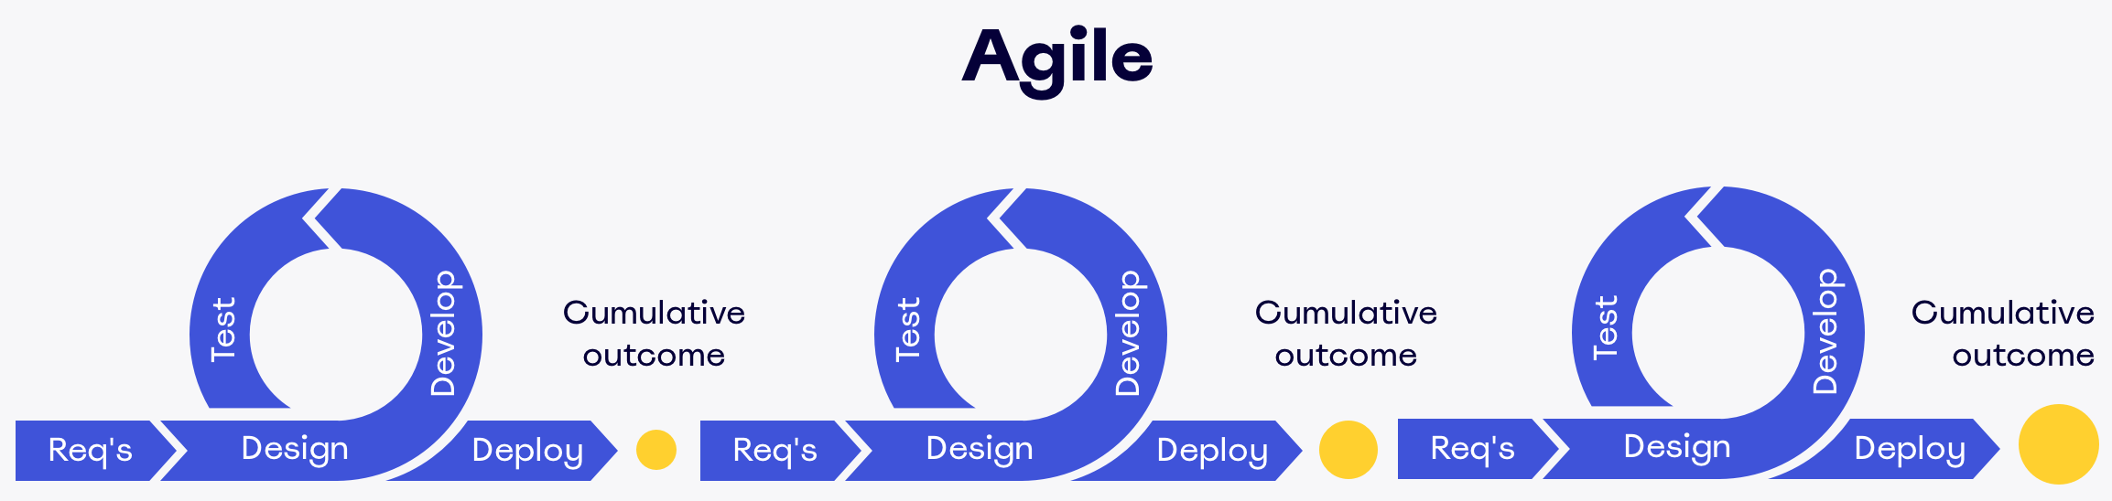
AGILE OVERVIEW
An adaptive approach to project management:
Notes:
An adaptive approach allows us to complete a step, evaluate and refine if/as needed and then move onto as determined from the evaluation.

Slide 9
APPROACHES TO PROJECT MANAGEMENT
Who was using a Waterfall approach?
Who was using an Agile approach?

Slide 10
APPROACHES TO PROJECT MANAGEMENT
How can we use these approaches support
your own personal project management planning?
Let’s discuss your next output: ETL

Slide 11
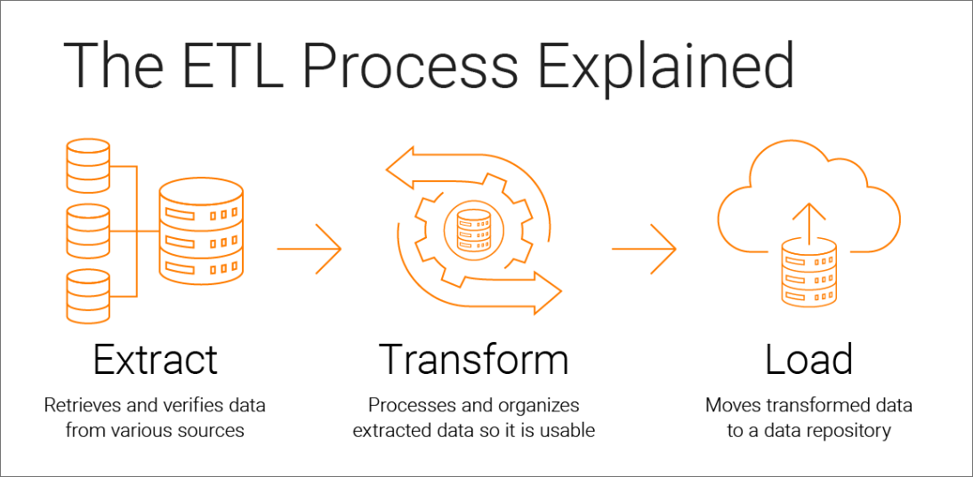
COMPLETING AN ETL
Notes:
How did your group approach creation and documentation of your ETL?
Considering waterfall or agile which approach would help you with your ETL design?

Slide 12
Capstone Project Management Plan
You will need to also plan to include:
Napkin Design
Transformation
Visualizations
Presentation
Notes:
Additional areas that we will cover when we introduce our individual capstone will be the three remaining outputs which are Napkin Design, Visualizations, and your presentation.

Slide 13
Progressive Capstone
Introduction to Capstone
Expectations and Components

Slide 14
PROGRESSIVE CASTONE
This is an individually executed project
It has the same requirements as Stage 3’s Mastery Project
There will be completion dates for each output
There will be office hours in which you can meet with Jermaine or Myself to review your work
You can lean on your peers, networked presenters and ADP shadow partners for support.

Slide 15
DEADLINES
Output | Deadline
PMP | EOD 21st
ETL Documentation | EOD 26th
Napkin Design | EOD 26th
Visualizations | EOD May 4th
Presentation | EOD May 9 / May 10

Slide 16
CAPSTONE RUBRIC
Criteria | Non-Performance (0) | Basic (1) | Proficient (2) | Distinguished (3) | Criterion Score
Presentation |  |  |  |  | 0
Situation/Task Explanation | Problem is not explained. | Problem is explained without impact to business identified. | Impact to business is identified, but problem is not explained. | Problem is explained with impact to business identified.
Presentation Materials | Materials are not proofread or organized. | Materials have several grammatical errors and poorly organized. | Materials have minimal grammatical errors and are fairly organized. | Materials are free of grammatical errors and logically organized.
Concepts |  |  |  |  | 0
Analysis Efforts | Only raw data is presented. | Analysis is presented without data development. | Presentation includes partial raw data. | Data are developed and analysis is presented.
Statistics Application | Statistics and mathematics not applied to analysis | General mathematics calculated. | General mathematics applied to analysis. | Analysis results are based off of statistical application.
Data Quality | Data does not actively meet fit for purpose. | Data selected is a mix of fit for purpose and unrelated data. |  | Data is selected based on fit for purpose.
Impact of Analysis | Recommendations are not made. | Recommendations are made, but do not include impact of analysis. | Impact of analysis included, but no recommendations made. | Strong recommendations based on analysis results and impact.
Data Visualization | Results are cluttered and not visually appealing. | Results are cluttered and minimally visually appealing. | Results are clear, but not visually appealing. | Results are clear and visually appealing.
Storytelling Analysis Results | Analysis results are not communicated. | Analysis results are not explained logically. | Analysis results are minimally explained. | Analysis results are explained logically.

Slide 17
Capstone Database
Introduction

Slide 18
INTRODUCTION TO ABCAnalytics DATABASE
Access
DIG
SQL

